Slide 1

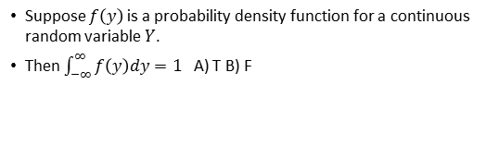
Continuous distributions
Suppose $f\left(y\right)$ is a probability density function for a continuous random variable $Y$.
Then $\int_{−∞}^{∞}{f\left(y\right)dy=1}$ A) T B) F

Slide 2
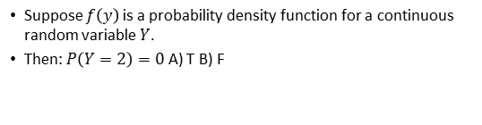
Continuous distributions
Suppose $f\left(y\right)$ is a probability density function for a continuous random variable $Y$.
Then: $P\left(Y=2\right)=0$ A) T B) F

Slide 3
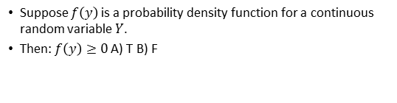
Continuous distributions
Suppose $f\left(y\right)$ is a probability density function for a continuous random variable $Y$.
Then: $f\left(y\right)≥0$A) T B) F

Slide 4
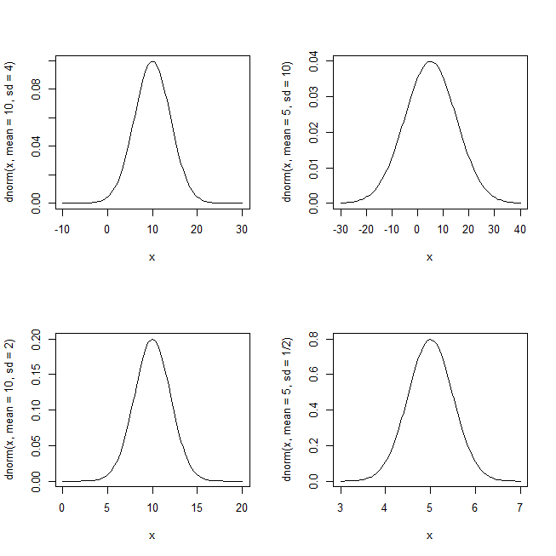
Which line is NOT plotted?
A) curve(dnorm(x, mean=10,sd=4),xlim=c(-10,30))
B) curve(dnorm(x, mean=10,sd=2),xlim=c(0,20))
C) curve(dnorm(x, mean=5,sd=10),xlim=c(-30,40))
D) curve(dnorm(x, mean=5,sd=1/2),xlim=c(4,7))

Slide 5
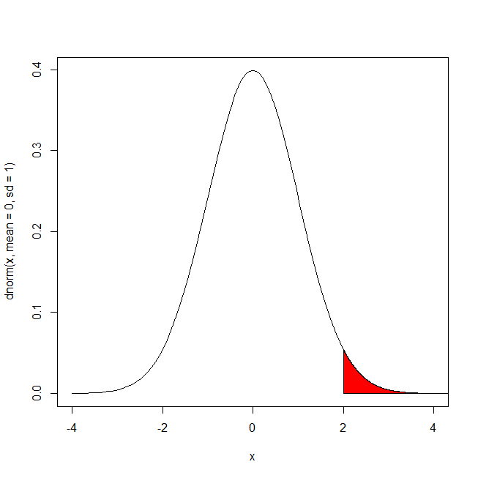
What is the size of the area shaded?
A) 0.5
B) 0.7
C) < 0.5
D) > 0.5

Slide 6
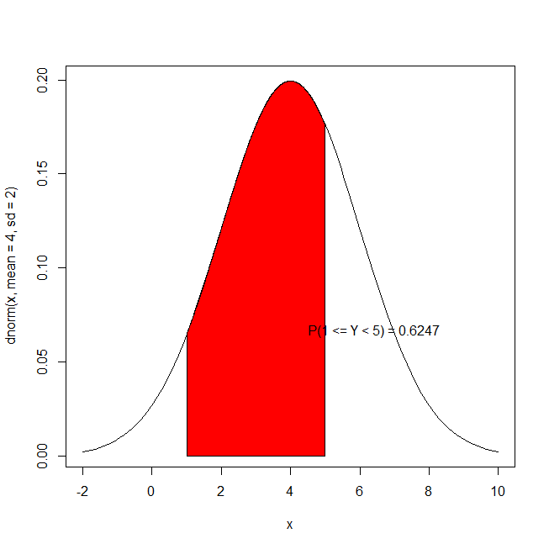
Which line is incorrect?
A) curve(dnorm(x, mean=4,sd=2),xlim=c(-2,10))
B) xcurve=seq(1,5,length=1000)
C) ycurve=dnorm(xcurve,mean=4,sd=2)
D)polygon(c(1,xcurve,6),c(0,ycurve,0),col="Red")
E) text(locator(1),paste("P(1 <= Y < 5)","=",round(pnorm(5,mean=4,sd=2)-pnorm(1,mean=4,sd=2),4)))

Slide 7
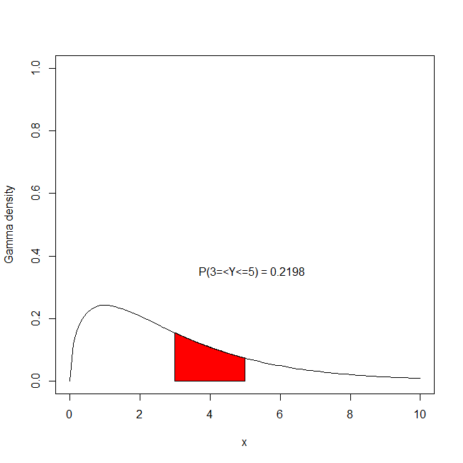
What line calculates the area?
A) curve(dchisq(x, df=3),xlim=c(0,10),ylim=c(0,1),ylab="Gamma density")
B) xcurve=seq(3,5,length=1000)
C) ycurve=dchisq(xcurve,df=3)
D)polygon(c(3,xcurve,5),c(0,ycurve,0),col="Red")
E)text(locator(1),paste("P(3=<Y<=5)","=",round(pchisq(5,df=3)-pchisq(3,df=3),4)))

Slide 8
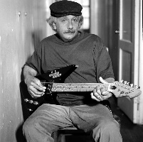
HWK due Wed
Read Examples 6.1,2,3 page212

Slide 9
m

Slide 11
GO TO Example

Slide 12
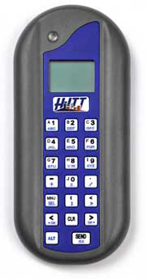
Are there independent categorical trials?
A) Yes
B) No
C) I don’t know
25% of bottled water is just tap water packaged in a bottle. Consider a sample of five bottled water brands. Let Y = number of these brands that use tap water.

Slide 14
Is the number of trials fixed?
A) Yes
B) No
C) I don’t know
25% of bottled water is just tap water packaged in a bottle. Consider a sample of five bottled water brands. Let Y = number of these brands that use tap water.

Slide 16
Are there more than two categories?
A) Yes
B) No
C) I don’t know
25% of bottled water is just tap water packaged in a bottle. Consider a sample of five bottled water brands. Let Y = number of these brands that use tap water.

Slide 18
Are there 2 or more trials?
A) Yes
B) No
C) I don’t know
25% of bottled water is just tap water packaged in a bottle. Consider a sample of five bottled water brands. Let Y = number of these brands that use tap water.

Slide 19
BINOMIAL

Slide 20

Are there independent categorical trials?
A) Yes
B) No
I don’t know
Suppose the number Y of cracks per concrete specimen is approximately 2.5 (We are interested in the number of cracks per Block)

Slide 22
Is there a constant rate?
A) Yes
B) No
I don’t know
Suppose the number Y of cracks per concrete specimen is approximately 2.5

Slide 24

POISSON

Slide 26
Are there independent categorical trials?
A) Yes
B) No
C) I don’t know
Assume hitting oil at one drilling location is independent of another and the probability of a success is 0.3. What is the probability that a driller will hit oil for the first time on the 10th drilling?

Slide 28
Is the number of trials fixed?
A) Yes
B) No
C) I don’t know
Assume hitting oil at one drilling location is independent of another and the probability of a success is 0.3. What is the probability that a driller will hit oil for the first time on the 10th drilling?

Slide 30
Trials to first success?
A) Yes
B) No
C) I don’t know
Assume hitting oil at one drilling location is independent of another and the probability of a success is 0.3. What is the probability that a driller will hit oil for the first time on the 10th drilling?

Slide 32
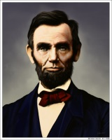
GEOMETRIC

Slide 34
Are there independent categorical trials?
A) Yes
B) No
C) I don’t know
An experiment is conducted to select a suitable catalyst for the commercial production of ethylene diamine (EDA – used in soap). Suppose a chemical engineer randomly selects 3 catalysts for testing from among a group of 10 catalysts, 6 of which have low acidity and 4 of which have high acidity

Slide 36
Is there a constant rate?
A) Yes
B) No
C) I don’t know
An experiment is conducted to select a suitable catalyst for the commercial production of ethylene diamine (EDA – used in soap). Suppose a chemical engineer randomly selects 3 catalysts for testing from among a group of 10 catalysts, 6 of which have low acidity and 4 of which have high acidity

Slide 38

HYPER-GEOMETRIC

